Slide 1

Team 56: Fall Detection
Bi-Weekly Update 5 Nhan Nguyen, Justin Haryanto
Sponsor: Krishna Gadepally TA: Swarnabha Roy, Dalton W. Cyr
Notes:
Michelle

Slide 2
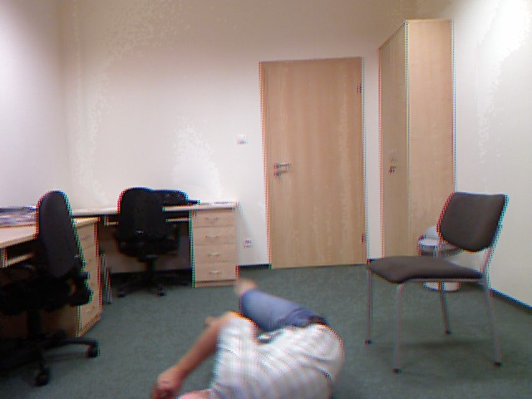
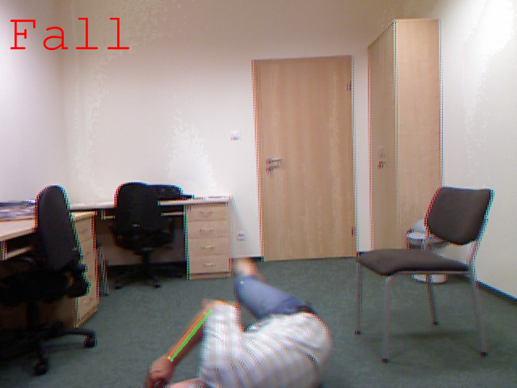
Project Summary
Problem
Design a video-based fall detection system
Solution
Convert video to a useable images
Apply bounding boxes and key points on people in images using pose estimation
Determine if a fall has occurred using Random Forests and CNN machine learning models
Notes:
30 seconds

Slide 3
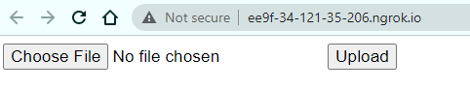
Integrated System Diagram
Website UI
Upload File
Post Result
Google Colab
User
Send File
Pose Estimation
Upload Result
Send Processed Data
Fall Detection

Slide 4
Project Timeline
Not Started
In Progress
Finished
Live Video
Video Processing
& Pose Estimation
Datasets
Random Forests
CNN
UI
Notes:
30 seconds

Slide 5
Nhan Nguyen
Accomplishments since last update 21 hrs of effort | Ongoing progress/problems and plans until the next presentation
Adapted the integrated fall detection and pose estimation system to the GUI system Additional testing and adjustments of ML models | Ongoing process of sending video results back to the website Testing basic full integrated system with small video clips Planning to clean the code of the integrated systems to improve issues with speed and smooth out the integration Planning to further adjust and test ML models after seeing results of testing with completely unseen and new data

Slide 6
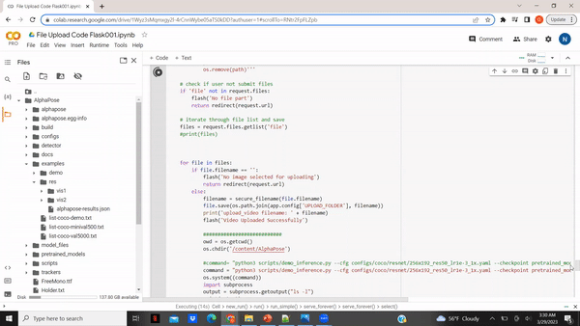
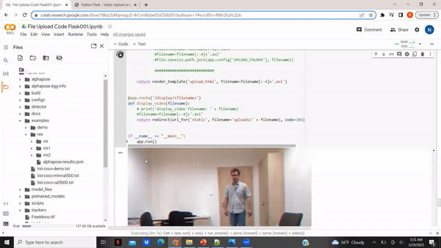
Nhan Nguyen

Slide 7
Justin Haryanto
Accomplishments since last update 24 hrs of effort | Ongoing progress/problems and plans until the next presentation
Recorded 78 5 second clips of falls for system testing Set up a website to allow for video and image uploads Displayed videos on the website | Website/GUI design Add image-to-video processing Input error checking Modify the testing videos to match goals set out in validation plan

Slide 8

Justin Haryanto

Slide 9
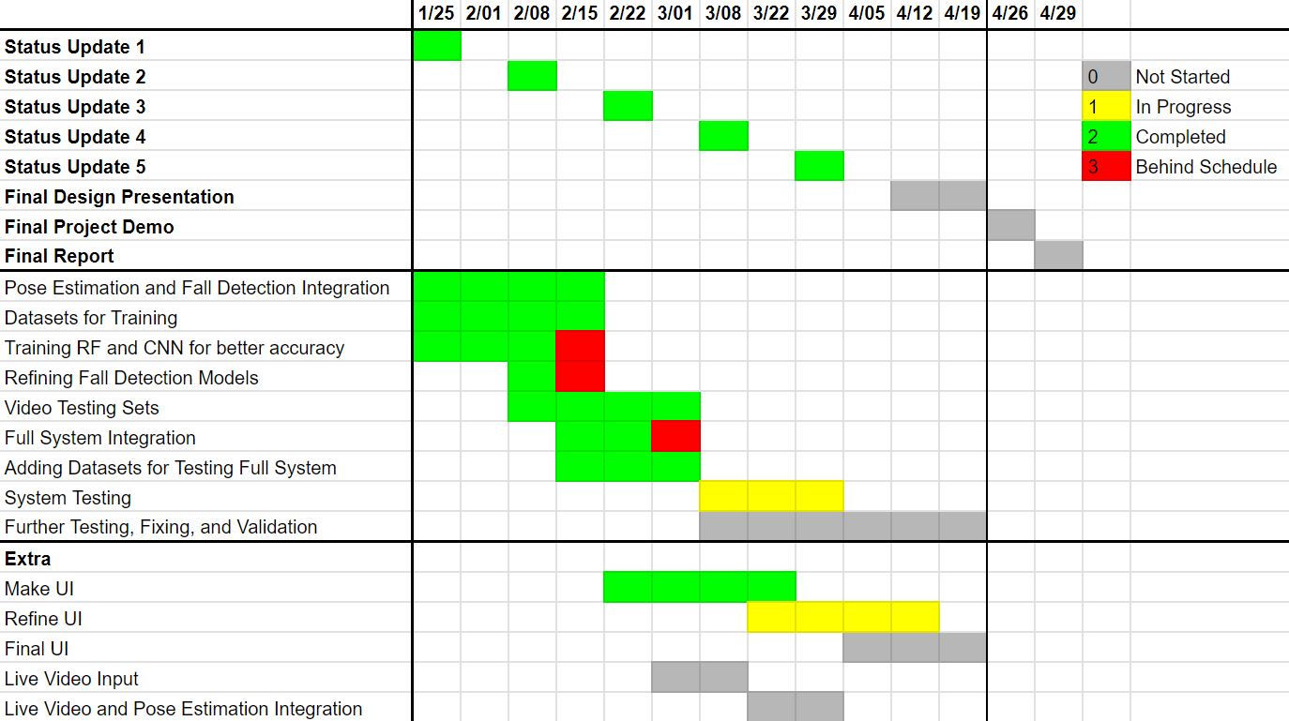
Execution Plan

Slide 10
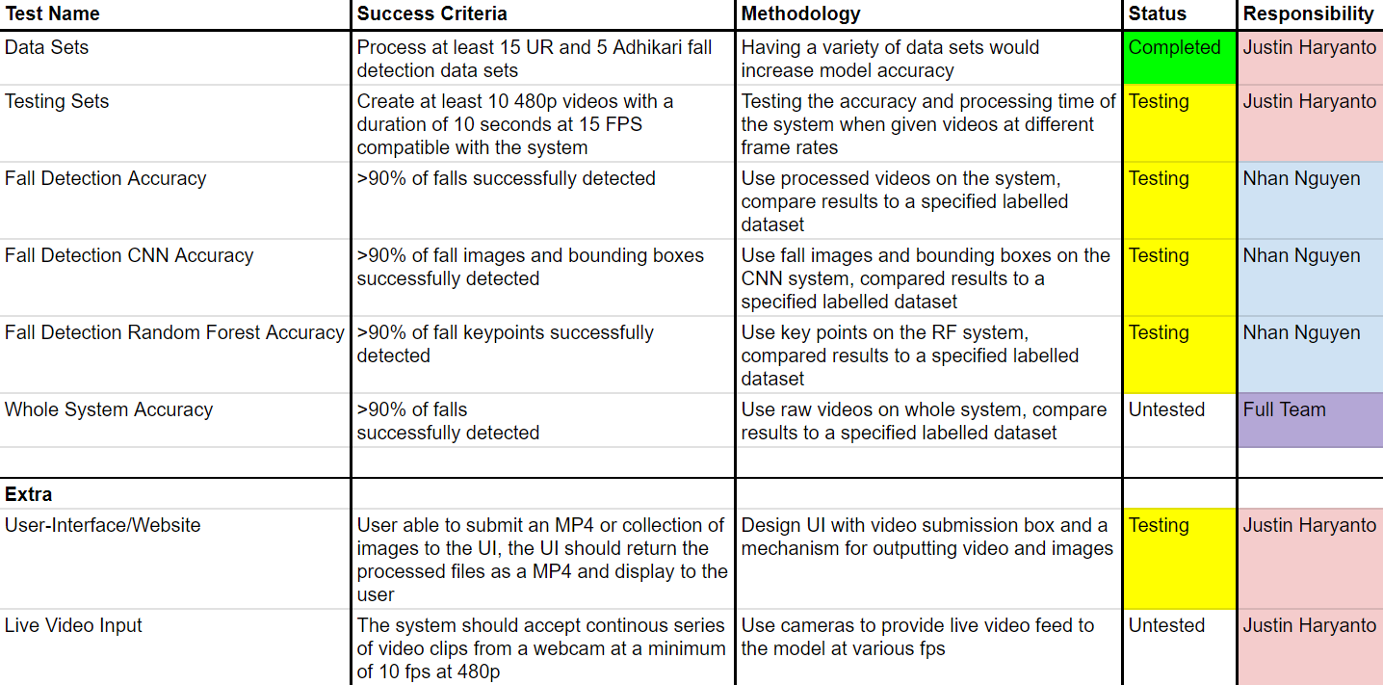
Validation Plan

Slide 11
Thank You
Notes:
30 seconds

